Slide 1
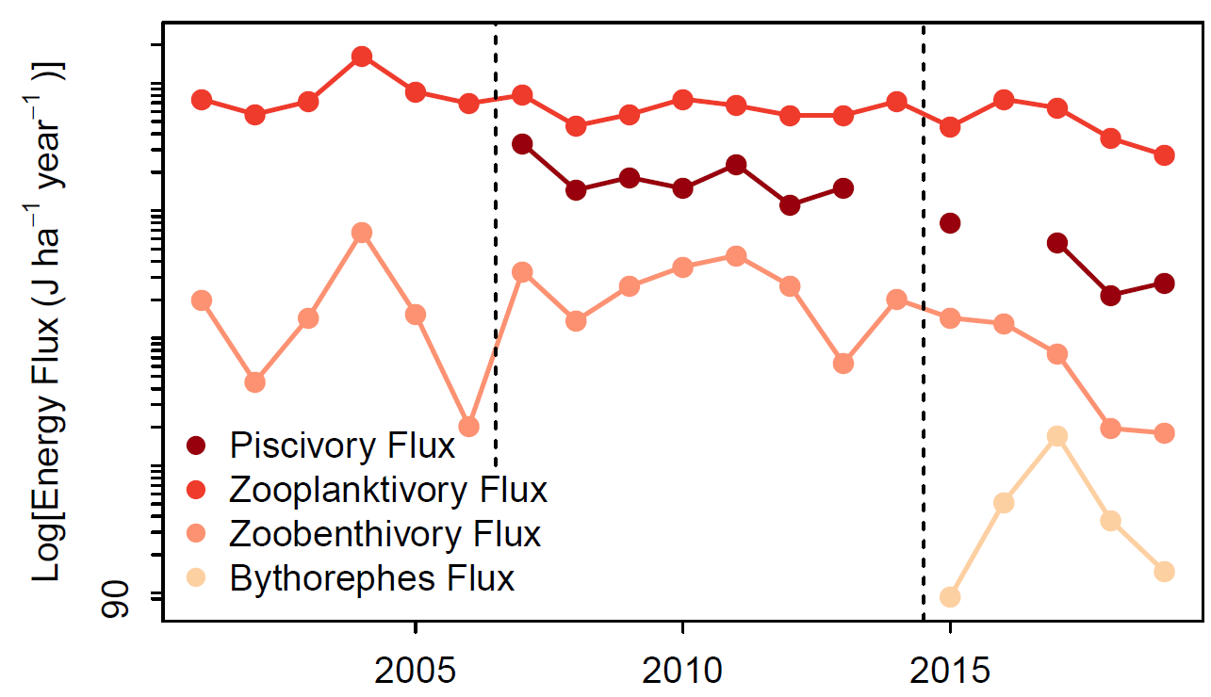
Binary matrix

Slide 2
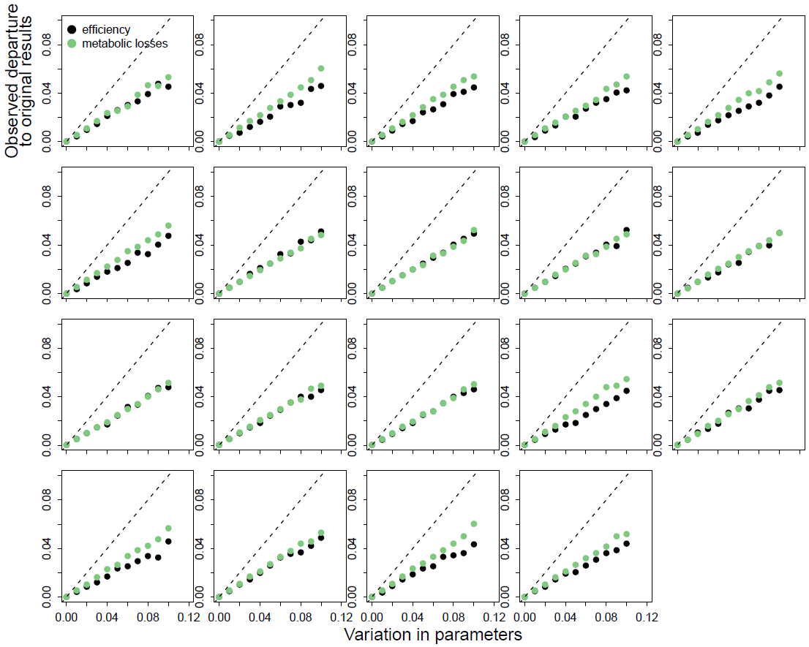
Binary food web matrix

Slide 3
 | Predators
Prey | cisco | lake.trout | walleye | bythotrephes | chaoborus | leptodora | mysis | cladocera | copepoda | rotifera
cisco | 0 | 1 | 1 | 0 | 0 | 0 | 0 | 0 | 0 | 0
lake.trout | 0 | 0 | 0 | 0 | 0 | 0 | 0 | 0 | 0 | 0
walleye | 0 | 0 | 0 | 0 | 0 | 0 | 0 | 0 | 0 | 0
bytho | 1 | 0 | 0 | 0 | 0 | 0 | 0 | 0 | 0 | 0
chaoborus | 1 | 1 | 0 | 0 | 0 | 0 | 0 | 0 | 0 | 0
leptodora | 1 | 1 | 0 | 0 | 0 | 0 | 0 | 0 | 0 | 0
mysis | 1 | 1 | 0 | 0 | 0 | 0 | 0 | 0 | 0 | 0
cladocera | 1 | 0 | 0 | 1 | 1 | 1 | 1 | 0 | 0 | 0
copepoda | 1 | 0 | 0 | 1 | 1 | 0 | 1 | 0 | 0 | 0
rotifera | 1 | 0 | 0 | 0 | 0 | 1 | 1 | 0 | 0 | 0

Slide 4
Preference Matrix
2001 - 2014
 | Predators
Prey | cisco | lake.trout | walleye | chaoborus | leptodora | mysis | cladocera | copepoda | rotifera
cisco | 0 | 0.9 | 1 | 0 | 0 | 0 | 0 | 0 | 0
lake.trout | 0 | 0 | 0 | 0 | 0 | 0 | 0 | 0 | 0
walleye | 0 | 0 | 0 | 0 | 0 | 0 | 0 | 0 | 0
chaoborus | 0.03 | 0.06 | 0 | 0 | 0 | 0 | 0 | 0 | 0
leptodora | 0.04 | 0.01 | 0 | 0 | 0 | 0 | 0 | 0 | 0
mysis | 0.03 | 0.03 | 0 | 0 | 0 | 0 | 0 | 0 | 0
cladocera | 0.4 | 0 | 0 | 0.5 | 0.5 | 0.4 | 0 | 0 | 0
copepoda | 0.4 | 0 | 0 | 0.5 | 0 | 0.3 | 0 | 0 | 0
rotifera | 0.1 | 0 | 0 | 0 | 0.5 | 0.3 | 0 | 0 | 0

Slide 5
Preference Matrix
2015 - 2021
 | Predators
Prey | cisco | lake.trout | walleye | bythotrephes | chaoborus | leptodora | mysis | cladocera | copepoda | rotifera
cisco | 0 | 0.9 | 1 | 0 | 0 | 0 | 0 | 0 | 0 | 0
lake.trout | 0 | 0 | 0 | 0 | 0 | 0 | 0 | 0 | 0 | 0
walleye | 0 | 0 | 0 | 0 | 0 | 0 | 0 | 0 | 0 | 0
bytho | 0.1 | 0 | 0 | 0 | 0 | 0 | 0 | 0 | 0 | 0
chaoborus | 0.02 | 0.06 | 0 | 0 | 0 | 0 | 0 | 0 | 0 | 0
leptodora | 0.03 | 0.01 | 0 | 0 | 0 | 0 | 0 | 0 | 0 | 0
mysis | 0.02 | 0.03 | 0 | 0 | 0 | 0 | 0 | 0 | 0 | 0
cladocera | 0.4 | 0 | 0 | 0.5 | 0.5 | 0.5 | 0.4 | 0 | 0 | 0
copepoda | 0.4 | 0 | 0 | 0.5 | 0.5 | 0 | 0.3 | 0 | 0 | 0
rotifera | 0.03 | 0 | 0 | 0 | 0 | 0.5 | 0.3 | 0 | 0 | 0

Slide 6
2015 - 2019
cisco | lake.trout | walleye | bythotrephes | chaoborus.larvae | leptodora | mysis | cladocera | copepoda | rotifera
0 | 0.9 | 1 | 0 | 0 | 0 | 0 | 0 | 0 | 0
0 | 0 | 0 | 0 | 0 | 0 | 0 | 0 | 0 | 0
0 | 0 | 0 | 0 | 0 | 0 | 0 | 0 | 0 | 0
0.1 | 0 | 0 | 0 | 0 | 0 | 0 | 0 | 0 | 0
0.02 | 0.06 | 0 | 0 | 0 | 0 | 0 | 0 | 0 | 0
0.03 | 0.01 | 0 | 0 | 0 | 0 | 0 | 0 | 0 | 0
0.02 | 0.03 | 0 | 0 | 0 | 0 | 0 | 0 | 0 | 0
0.4 | 0 | 0 | 0.5 | 0.5 | 0.5 | 0.4 | 0 | 0 | 0
0.4 | 0 | 0 | 0.5 | 0.5 | 0 | 0.3 | 0 | 0 | 0
0.03 | 0 | 0 | 0 | 0 | 0.5 | 0.3 | 0 | 0 | 0

Slide 7
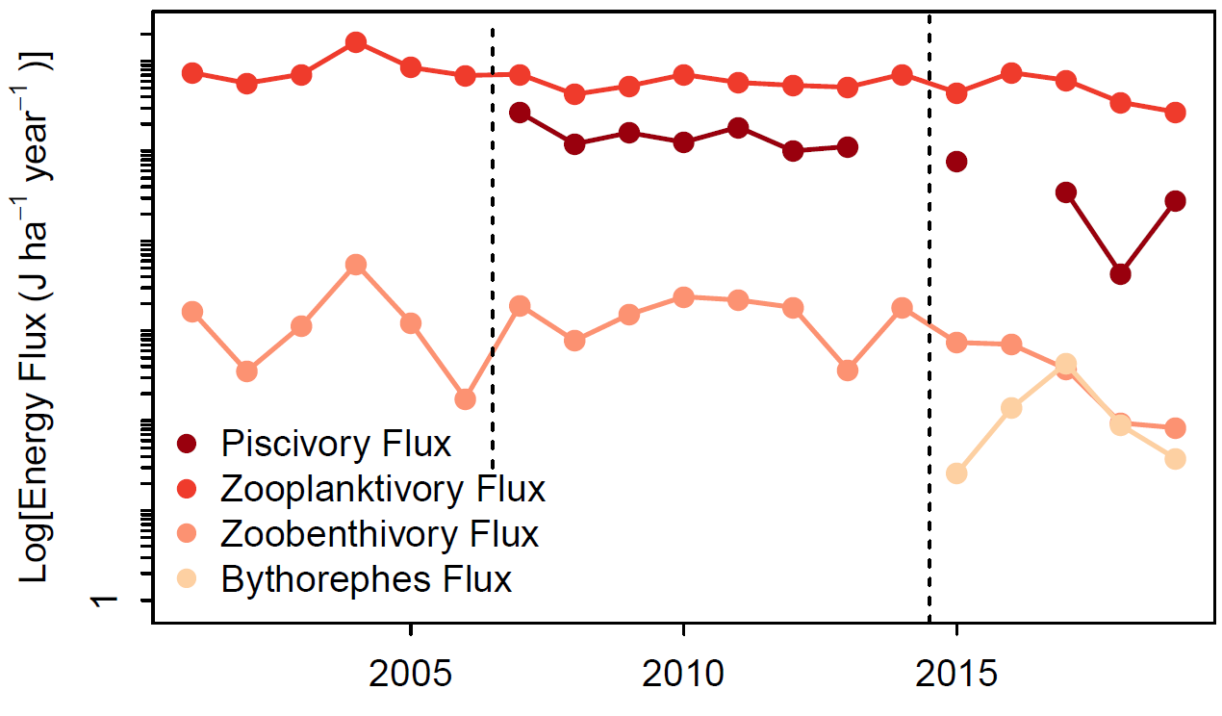
Preference matrix

Slide 8
Binary matrix

Slide 9
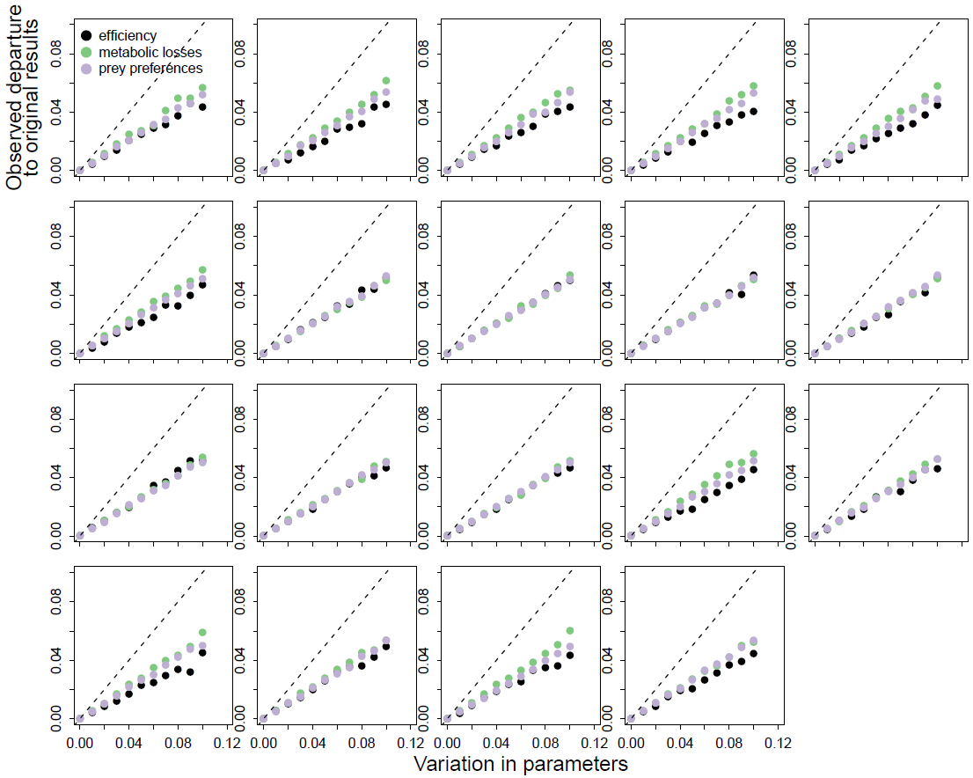
Preference food web matrix

Slide 10
Binary food web matrix

Slide 11
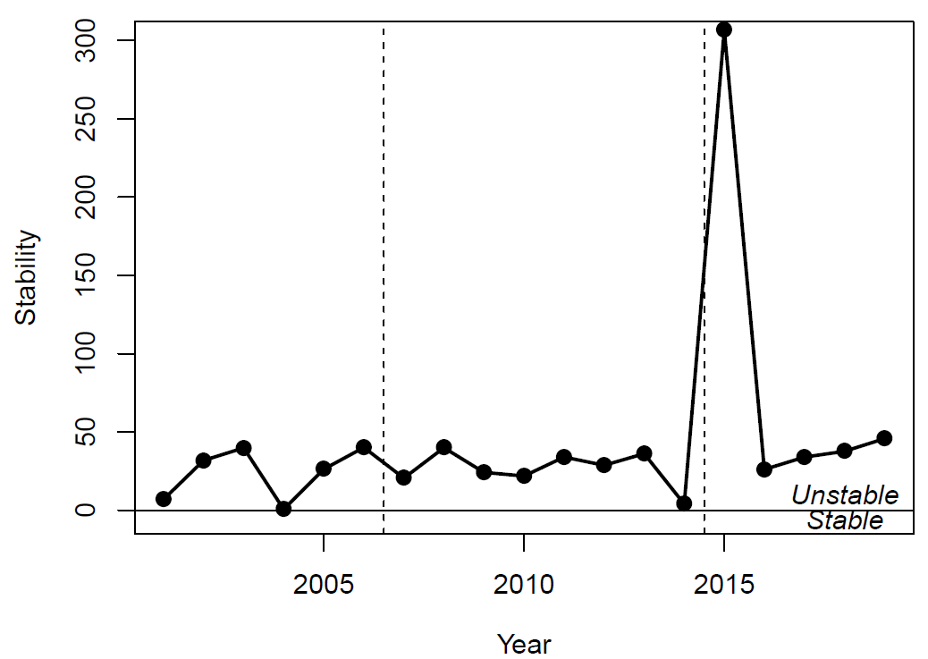
Binary matrix

Slide 12
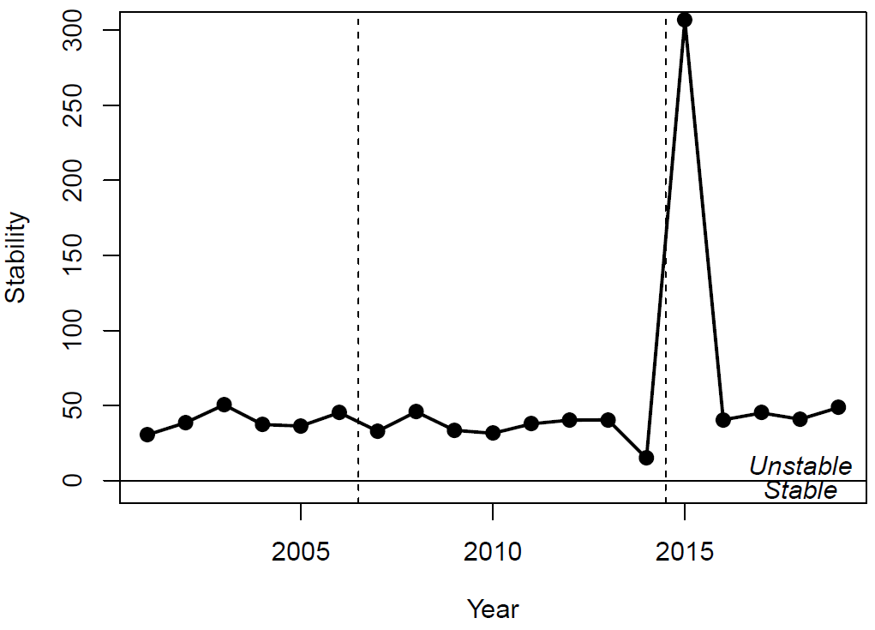
Preference matrix

